Slide 1


PCET’s Pimpri Chinchwad College of Engineering Advanced Machine Learning
Understanding the Vaccination Rate using Time Series Analysis
Presented by: Amulya Maitre (FYMTC08)
Under Guidance of: Dr. K. Rajeswari

Slide 2
Contents
Introduction
Source of Data
Literature Survey
Observations
Conclusion

Slide 3
Introduction
The pandemic of novel Coronavirus, has led to a devastating situation all around the globe. With the introduction of vaccines by various pharmaceutical companies, there is a hope of recovery from this dreadful condition. Hence, the governments all over the world emphasize on getting their citizens vaccinated. A Machine Learning (ML) approach can be very effectively used to understand the trends of vaccinations in various countries. This might be helpful to apprehend which country needs more attention, in terms of vaccine supply or creating awareness amongst the citizens.

Slide 4
Data on COVID-19 (coronavirus) vaccinations by Our World in Data
Country-by-country data on global COVID-19 vaccinations. The dataset relies only on figures that are verifiable based on public official sources.
This dataset includes some subnational locations (England, Northern Ireland, Scotland, Wales, Northern Cyprus…) and international aggregates (World, continents, European Union…). They can be identified by their iso_code that starts with OWID_.
location: name of the country (or region within a country).
iso_code: ISO 3166-1 alpha-3 – three-letter country codes.
date: date of the observation.
total_vaccinations: total number of doses administered. This is counted as a single dose and may not equal the total number of people vaccinated, depending on the specific dose regime (e.g., people receive multiple doses). If a person receives one dose of the vaccine, this metric goes up by 1. If they receive a second dose, it goes up by 1 again.
total_vaccinations_per_hundred: total_vaccinations per 100 people in the total population of the country.
https://ourworldindata.org/coronavirus-source-data

Slide 5
Data on COVID-19 (coronavirus) vaccinations by Our World in Data
daily_vaccinations: new doses administered per day (7-day smoothed). For countries that don't report data on a daily basis, we assume that doses changed equally on a daily basis over any periods in which no data was reported. This produces a complete series of daily figures, which is then averaged over a rolling 7-day window. An example of how we perform this calculation can be found here.
daily_vaccinations_per_million: daily_vaccinations per 1,000,000 people in the total population of the country.
people_vaccinated: total number of people who received at least one vaccine dose. If a person receives the first dose of a 2-dose vaccine, this metric goes up by 1. If they receive the second dose, the metric stays the same.
people_vaccinated_per_hundred: people_vaccinated per 100 people in the total population of the country.
people_fully_vaccinated: total number of people who received all doses prescribed by the vaccination protocol. If a person receives the first dose of a 2-dose vaccine, this metric stays the same. If they receive the second dose, the metric goes up by 1.
people_fully_vaccinated_per_hundred: people_fully_vaccinated per 100 people in the total population of the country.

Slide 6
Literature Survey
Sr. No. | Paper Title | Methods | Datasets | Performance Metrics | Strength | Limitations | Remarks/Gaps
1. | Sahisnu, Julian Satya, et al. Vaccine Prediction System Using ARIMA Method. ICIC International, 2020. DOI.org (CSL JSON), https://doi.org/10.24507/icicelb.11.06.567. | ARIMA (Auto-Regressive Integrated Moving Average) Mean absolute percentage error for accuracy calculation | Vaccine stock history data at the South Tangerang City Health Center (2013 – 2017) | Hypothesis Testing - Augmented Dickey-Fuller (ADF) test | Accuracy of the ARIMA method (1, 1, 16) is 91.38% | None | Apply this methodology to a larger scale (provincial Health Services in Jakarta, Banten and West Java)
2. | Vithalrao Kendre, Varsharani, et al. “FORECASTING MEASLES VACCINE REQUIREMENT BY USING TIME SERIES ANALYSIS.” Journal of Evolution of Medical and Dental Sciences, vol. 6, no. 28, Apr. 2017, pp. 2329–33. DOI.org (Crossref), doi:10.14260/Jemds/2017/501. | Expert Modeler - simple seasonal model Autocorrelation function (ACF) Partial correlation function (PACF) | Data from Government Medical College, Latur (2009-10 to 2014-15: 8015 doses of measles vaccine) | Mean absolute percentage error (MAPE) | 𝑅-squared value obtained was 0.758 i.e., model could explain 75% of the observed variation in the series | None | Simple seasonal model of Time series analysis can be used to forecast Measles vaccine requirement at Medical Colleges

Slide 7
Literature Survey
Sr. No. | Paper Title | Methods | Datasets | Performance Metrics | Strength | Limitations | Remarks/Gaps
3. | Singh, Saswat, et al. “Time Series Analysis of COVID-19 Data to Study the Effect of Lockdown and Unlock in India.” Journal of The Institution of Engineers (India): Series B, Apr. 2021. Springer Link, doi:10.1007/s40031-021-00585-7. | TBAT (T: Trigonometric seasonality, B: Box–Cox transformation, A: ARIMA errors, T: Trend, S: Seasonal components) Prophet Auto-regressive Integrated Moving Average (ARIMA) Moving Average Neural Basis Expansion Analysis (N-BEATS) Single Exponential Method Double Exponential Method | Official website of pre-legislative research (12 March 2020 - 2 July 2020) | root mean square error (RMSE) | ARIMA model, produces forecasts on the prior values of the time series and the error lags helps the model to adjust its prediction values from sudden change in trends. | N-Beats requires a large amount of previously estimated timestamp samples | ARIMA model has the best forecasting accuracy Creation of ensembles of the presented models Adoption of multivariate time series modeling Transfer learning

Slide 8
Literature Survey
Sr. No. | Paper Title | Methods | Datasets | Performance Metrics | Strength | Limitations | Remarks/Gaps
4. | Tuli, Shreshth, et al. “Predicting the Growth and Trend of COVID-19 Pandemic Using Machine Learning and Cloud Computing.” Internet of Things, vol. 11, Sept. 2020, p. 100222. DOI.org (Crossref), doi:10.1016/j.iot.2020.100222. | Iterative versions of Gaussian, Beta (4-parameter), Fisher-Tippet (Extreme Value distribution), and Log Normal functions Non-iteratively weighted Weibull “Robust Weibull fitting” model - iterative weighting strategy | Our World in Data by Hannah Ritchie (updated daily from the World Health Organization situation reports) | Mean Squared Error (MSE) Mean Absolute Percentage Error (MAPE) Coefficient of determination | Makes statistically better predictions | Gaussian model shows an over-optimistic picture of the COVID-19 scenario | Ensure accurate predictions are made and correct measures can be taken

Slide 9
Time Series Forecasting with ARIMA
ARIMA stands for AutoregRessive Integrated Moving Average, is a model that can be fitted to time series data in order to better understand or predict future points in the series.
There are three distinct integers (p,d,q) that are used to parametrize ARIMA models, i.e., ARIMA(p, d, q). Together these three parameters account for seasonality, trend, and noise in datasets:
p is the auto-regressive part of the model. It allows us to incorporate the effect of past values into our model. For e.g., stating that it is likely to be warm tomorrow if it has been warm the past 3 days.
d is the integrated part of the model. This includes terms in the model that incorporate the amount of differencing to apply to the time series. For e.g., stating that it is likely to be same temperature tomorrow if the difference in temperature in the last three days has been very small.
q is the moving average part of the model. This allows us to set the error of our model as a linear combination of the error values observed at previous time points in the past.
When dealing with seasonal effects, we make use of the seasonal ARIMA, which is denoted as ARIMA(p,d,q)(P,D,Q)s. The term s is the periodicity of the time series (4 for quarterly periods, etc.)

Slide 10
Time Series Forecasting with ARIMA
We use the following representation of the model for forecasting the vaccination rates in various countries.
𝐴𝑅𝐼𝑀𝐴(𝑝, 𝑑, 𝑓):
𝑋_{𝑡} = 𝛼₁𝑋_{𝑡}−1 + 𝛼₂𝑋_{𝑡}−2 + 𝛽₁𝑍_{𝑡}−1 + 𝛽₂𝑍_{𝑡}−2 + 𝑍_{𝑡} (1)
where, 𝑍_{𝑡} = 𝑋_{𝑡} − 𝑋_{𝑡}−1 (2)
Here, X_{t} is the predicted number of vaccinations done on t^{th} day, α₁, α₂, β_{1,} and β₂ are parameters whereas Z_{t} is the residual term for t^{th} day.

Slide 11
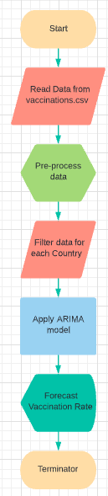
Flowchart of Implementation

Slide 12
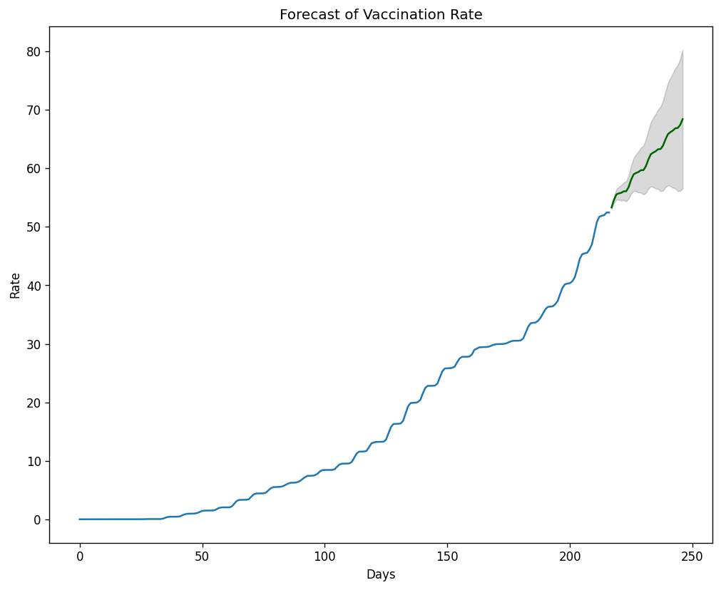
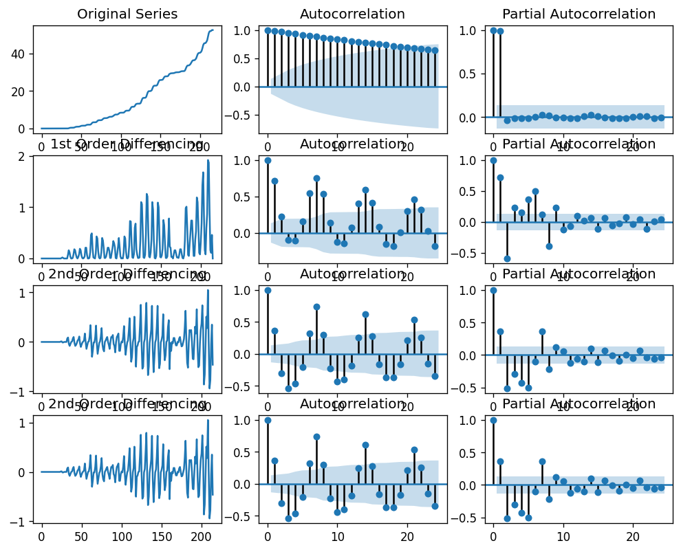
Observations – Developed Countries [Forecast for next 30 Days]
1. Norway
Best model: ARIMA(6,2,6)(0,0,0)[0]

Slide 13
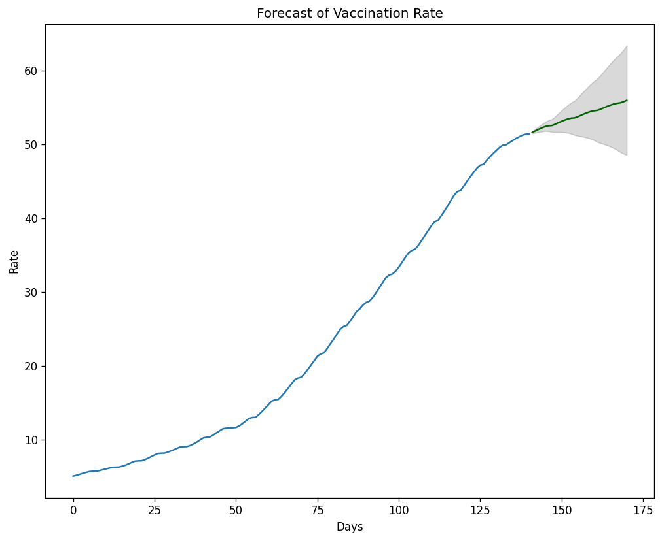
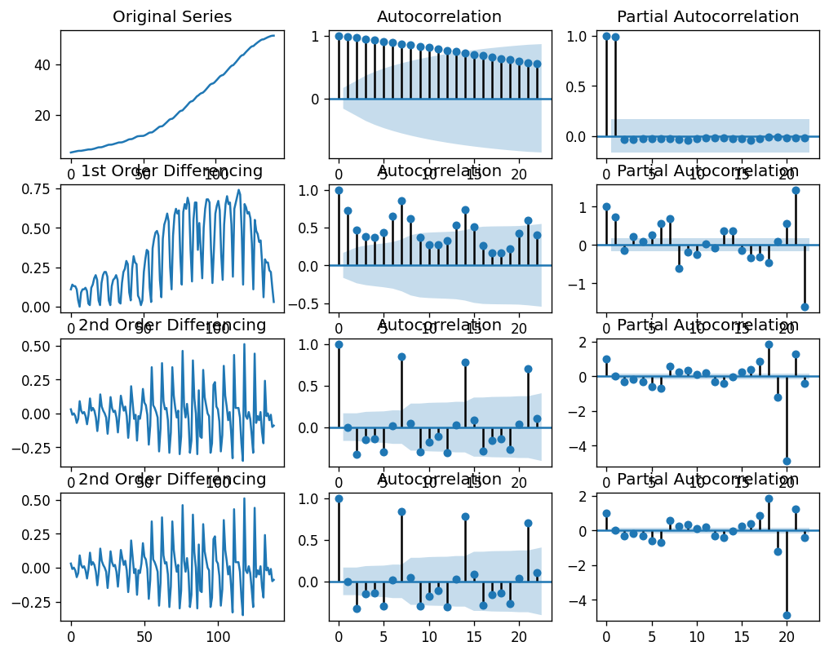
Observations – Developed Countries [Forecast for next 30 Days]
2. Switzerland
Best model: ARIMA(7,2,1)(0,0,0)[0]

Slide 14
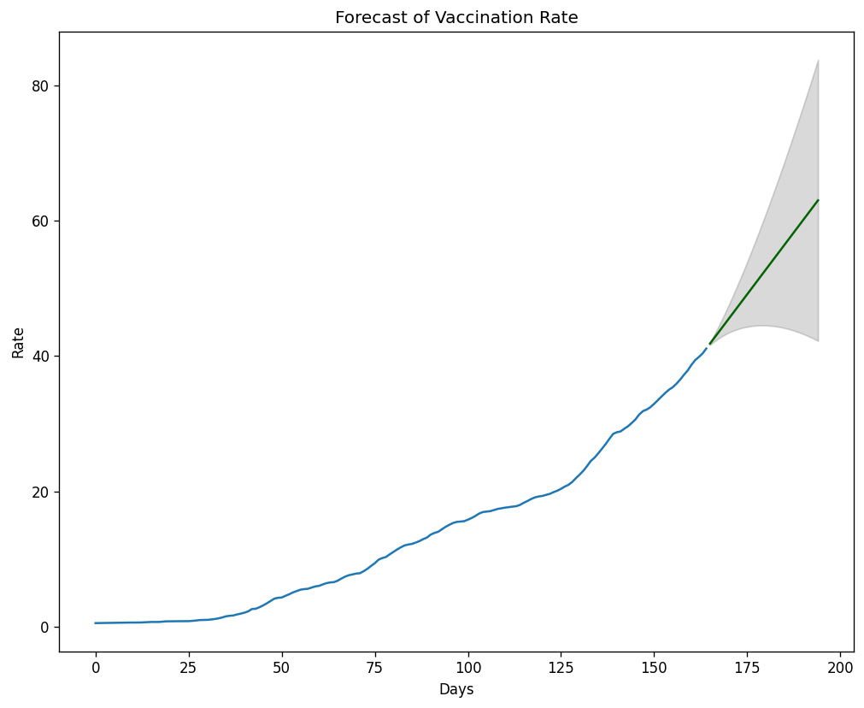
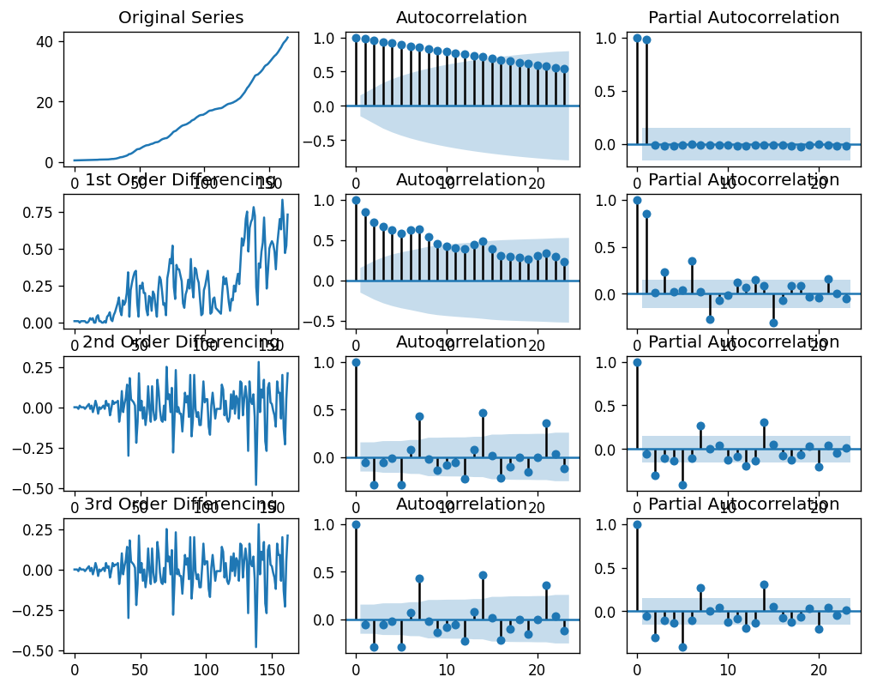
Observations – Developing Countries [Forecast for next 30 Days]
1. Argentina
Best model: ARIMA(0,2,0)(0,0,0)[0]

Slide 15
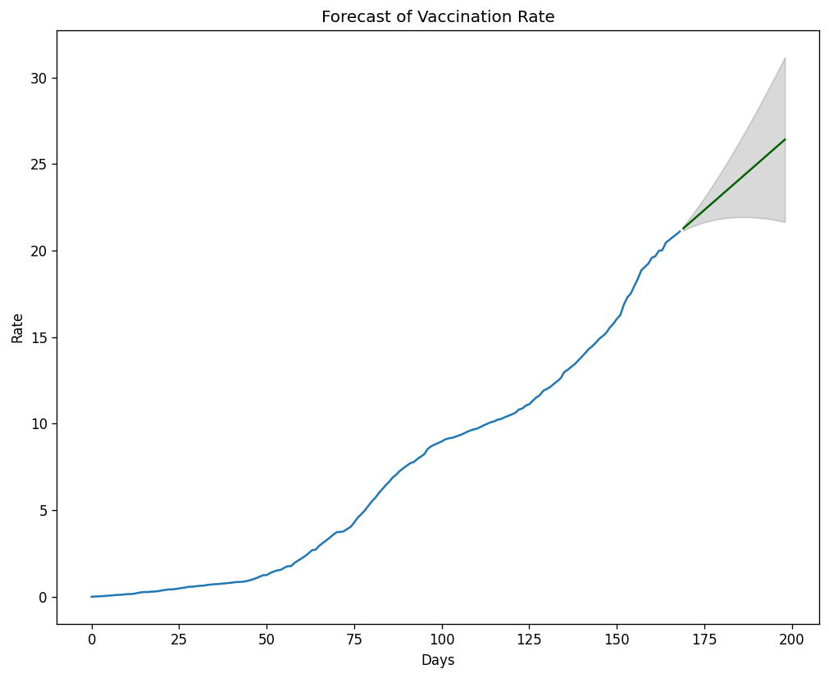
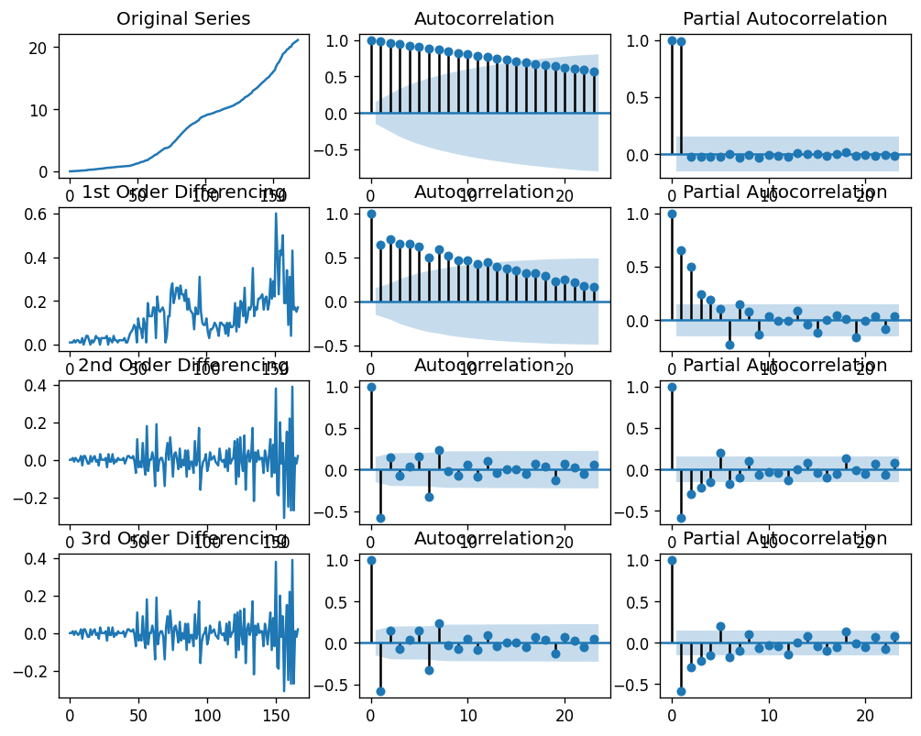
Observations – Developing Countries [Forecast for next 30 Days]
2. India
Best model: ARIMA(1,2,1)(0,0,0)[0]

Slide 16
Conclusion
From the observations, we can conclude that the vaccination rate for developing countries is increasing rapidly.
Also, we can state that due to social-awareness, the developing countries have also taken quick actions to provide vaccinations to their citizens and hence the vaccination rate is steadily increasing.
But due to lack of awareness, the underdeveloped countries have less data of vaccinations, due to which the vaccination rate can’t be forecasted. This implies that the governments of these countries need to work on spreading awareness and encourage their citizens to get vaccinated.

Slide 17
Thank You ☺

